Slide 1
ADA Boosting

Slide 2
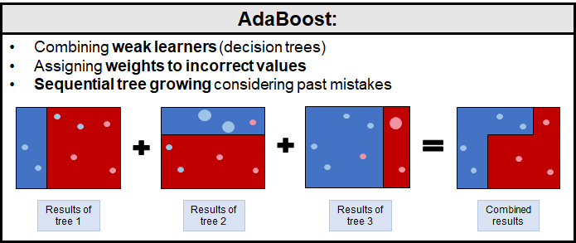
ADA Boost

Slide 3
What is ADA Boost
Meta estimator where it learns from its one type
Weights are adjusted
Errors are corrected
Weak learners are combined

Slide 4
When to use
Complex datasets where one decision tree will not work.
No overfitting
Learn from mistakes

Slide 5
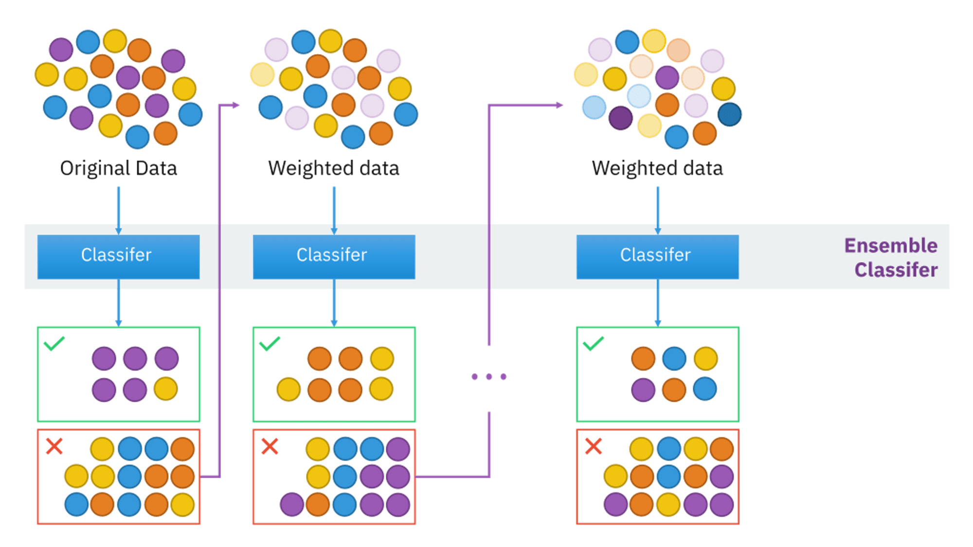

Slide 6
Advantages & Disadvantages
Advantages:
Easy to Use and fast
Versatile ( can handle both text and numeric data)
Disadvantages:
Sensitive to exceptional data
Weak classifiers may make the whole model underperform

